Slide 1
Analysis of the Most Popular U.S. Restaurant Chains in 2020
CS544 Term Project Presentation (Prof. Kalathur, Fall 2021)
Chen Wen, Yuandi Tang,Feifan Wang

Slide 2
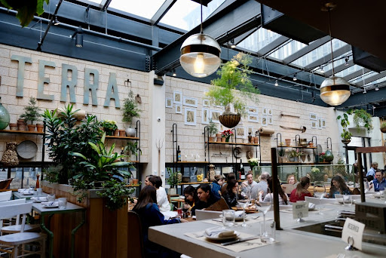
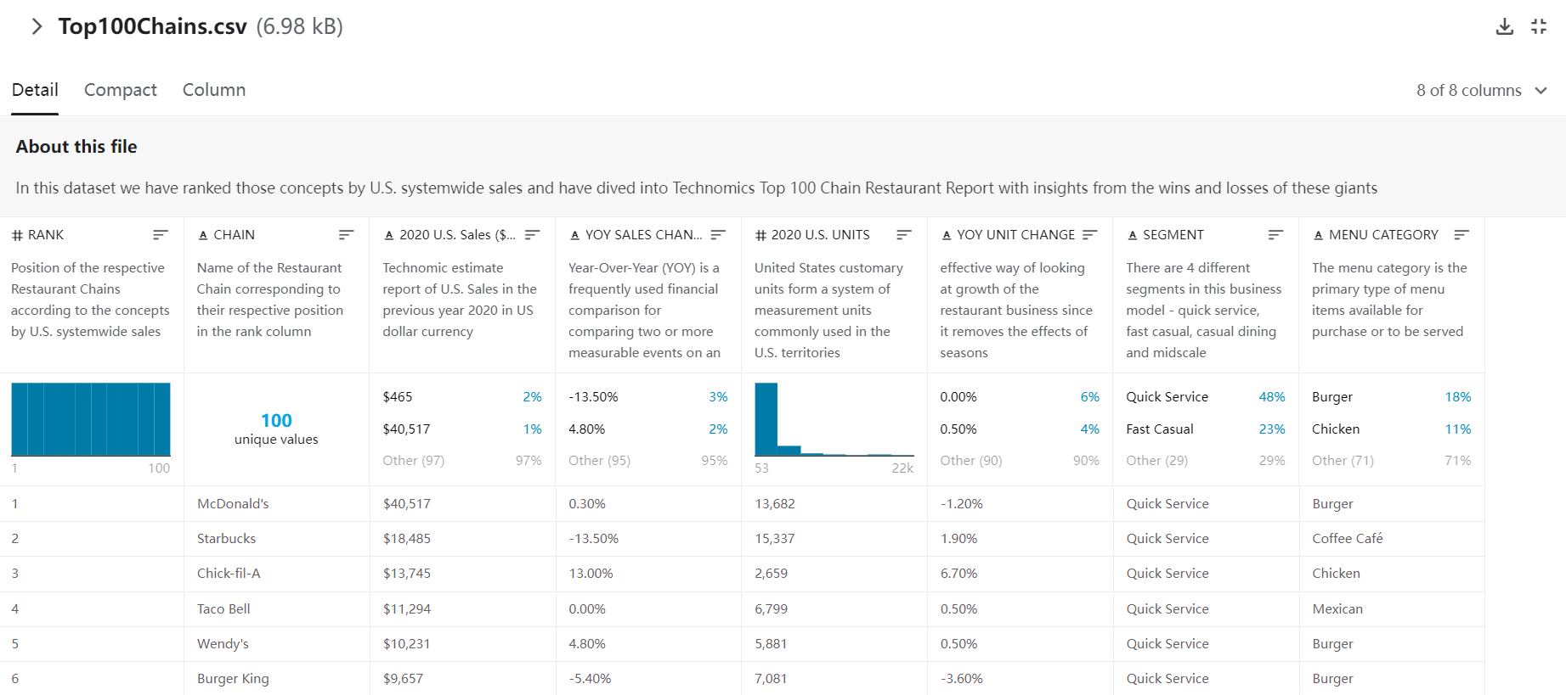
Dataset Introduction
This data is obtained from the Restaurant Business magazine website.This dataset carries the link between different chain restaurants with sales in 2020. This dataset supplies with the Top 100 chain restaurants in sales total,YOY changes in sales,unit numbers, YOY changes in units, segments and categories.

Slide 3
Data Preparation
str_sub(top100chains$X2020.U.S..Sales...000.000., 1, 1) <- ''
top100chains[73, 3] <- '511'
#remove punctuation
str_sub(top100chains$X2020.U.S..Sales...000.000.[1:46], -4, -4) <- ''
a <- as.numeric(top100chains$X2020.U.S..Sales...000.000.)
top100chains$X2020.U.S..Sales...000.000. <- a
#remove %
str_sub(top100chains$YOY.SALES.CHANGE, -1, -1) <- ''
b <- as.numeric(top100chains$YOY.SALES.CHANGE)
top100chains$YOY.SALES.CHANGE <- b
#remove ,
comma <- '([,])'
str_replace_all(top100chains$X2020.U.S..UNITS, comma, '')
top100chains$X2020.U.S..UNITS <- str_replace_all(top100chains$X2020.U.S..UNITS, comma, '')
c <- as.numeric(top100chains$X2020.U.S..UNITS)
top100chains$X2020.U.S..UNITS <- c
#remove %
str_sub(top100chains$YOY.UNIT.CHANGE, -1, -1) <- ''
d <- as.numeric(top100chains$YOY.UNIT.CHANGE)
top100chains$YOY.UNIT.CHANGE <- d
#remove \t
e <- str_trim(top100chains$SEGMENT)
top100chains$SEGMENT <- e
table(top100chains$SEGMENT)
f <- str_trim(top100chains$MENU.CATEGORY)
top100chains$MENU.CATEGORY <- f
Special Symbols-$,%,\t
Data type conversion

Slide 4
Data Preparation
Special Symbols-$,%,\t
Data type conversion
# convert to tibble
top100chains_tibble <- as_tibble(top100chains)

Slide 5
Questions
Which restaurants are biggest in total sales?
Which is biggest category in Top 100 restaurants?
Which are the biggest in YOY sales changes in Top 100 restaurants?
Which is biggest segments in Top 100 restaurants?
Which are the biggest in YOY units changes in Top 100 restaurants?
Which is biggest units in Top 100 restaurants?
Which are the outcomes for the cross features analysis
What are the investment suggestions for chain restaurants investors?
What are the correlation between these elements。

Slide 6
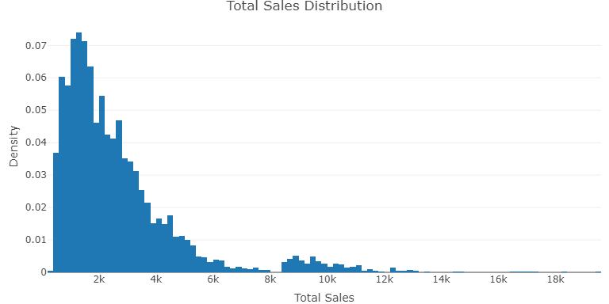
Data Analysis-Total Sales Distribution
Median Earnings Distributions are shown below. As expected with sales, the distribution is skewed to the right.

Slide 7
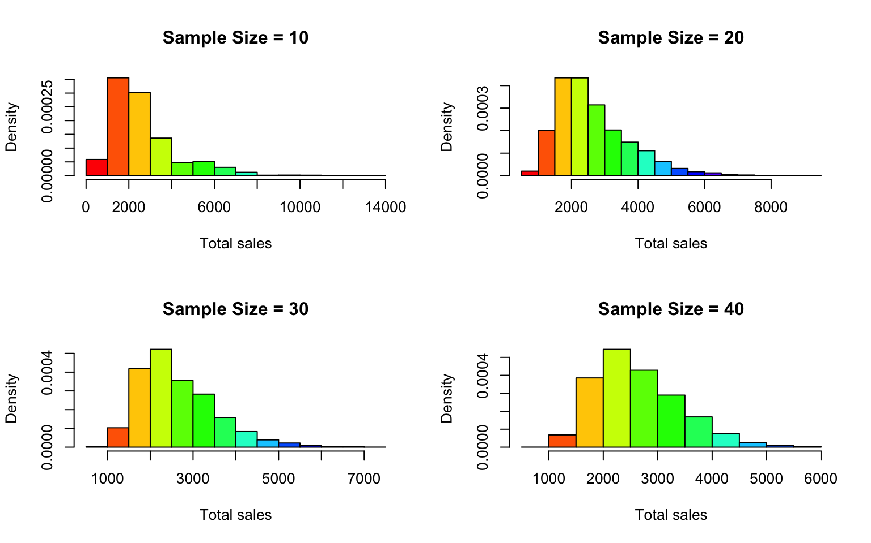
Sampling Analysis--Central Limit Theorem
Using the total sales attribute in this data set the applicability of the central limit theorem can be shown. As displayed in the histogram above, the distribution is normal. Below are histograms showing the sample means of 5000 random samples of sample sizes 10, 20, 30, and 40 following a normal distribution.
## [1] "Sales Mean = 2634.06 ,SD = 4926,714 "
## [1] "Sample Size = 10 Mean = 2626.71 ,SD = 1561.472"
## [1] "Sample Size = 20 Mean = 2620.87 ,SD = 1082.339"
## [1] "Sample Size = 30 Mean = 2636.771,SD = 891.9906"
## [1] "Sample Size = 40 Mean = 2644.189,SD = 785.7707"

Slide 8
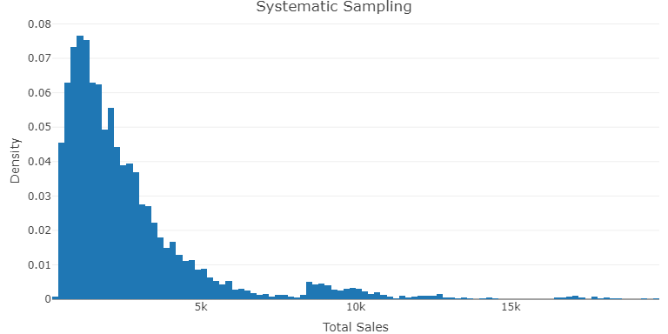

Sampling Analysis-Various Sampling
The numbers are highly condensed with among 0 to 5000, the Simple Random Sample Without Replacement and Systematic Sampling shows the same outcome.

Slide 9
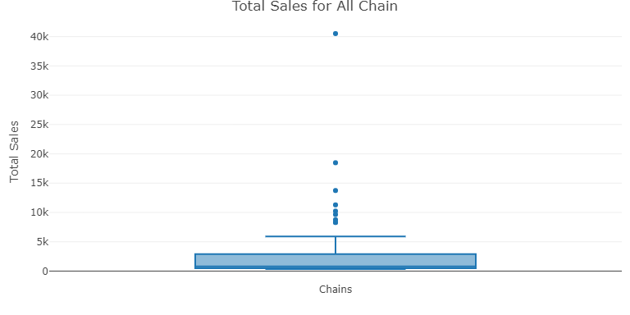
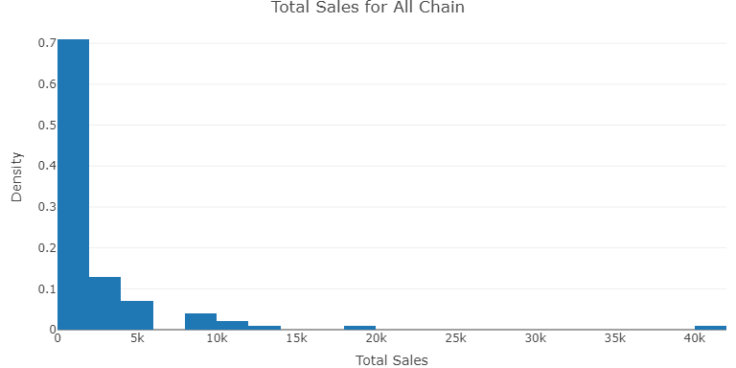
General Analysis-Total Sales for All Chains
By categorize total sales of top restaurants from 0 to 40000 with a step of 5000, the histogram and boxplot are shown above.
Findings
1.Total Sales are highly biased and uneven among all chains.
2.Above 80% of chain restaurants have sales in 0-5000 million
3.There is no top chain restaurants which sales is in the range from 20000 to 40000 million.
4.The biggest outlier(McDonald’s) is so distracted from the average total sales by 1000% higher than the mean
5.The 8 outliers in total sales are too high and pull the average far away from the mean and lower quartiles

Slide 10
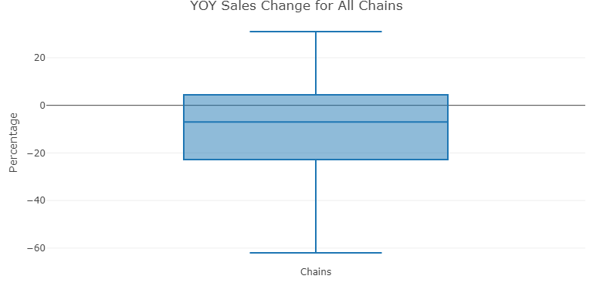
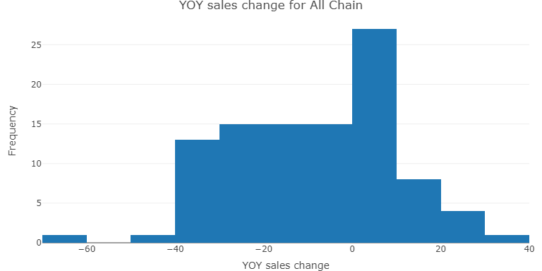
General Analysis-YOY sales change for All Chains
By categorize YOY sales changes of top restaurants from -60% to 40% with a step of 10%, the histogram and boxplot are shown above.
Findings
1.YOY sales changes are varied from a restaurant to another on the individually basis.
2.Most restaurants witnessed a slightly increase below 10% in 2020
3.The average increase rate for Top 100 restaurants is negative in 2020.
4.The worst restaurant worst witnessed a sharply decrease in YOY sales changes of over 50%.
5.Less than 10 restaurants have a increase over 20% in YOY sales changes

Slide 11
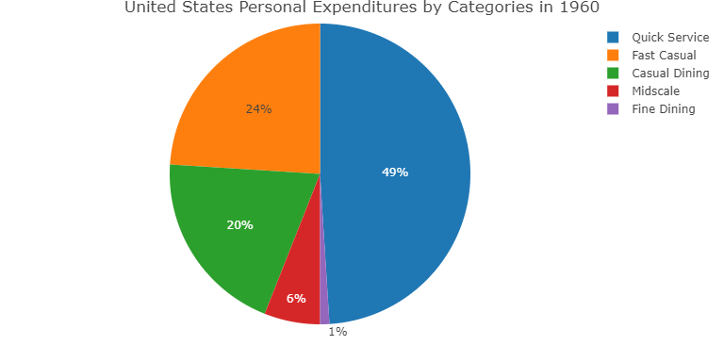
General Analysis-Proportion of Top 100 chain in segments
By calculating the porpotion in segments, the piechart is shown above.
Findings
1.Almost half restaurants in Top 100 chain is in quick service segments
2.Only one restaurant in Top chain is from fine dining in 2020
3.The fast casual restaurants share nearly the same portion with casual dining restaurants.
4.Midscale restaurants occupied around 5% in the Top 100 chain restaurants
5.The segments are highly biased in Top 100 chain restaurants

Slide 12
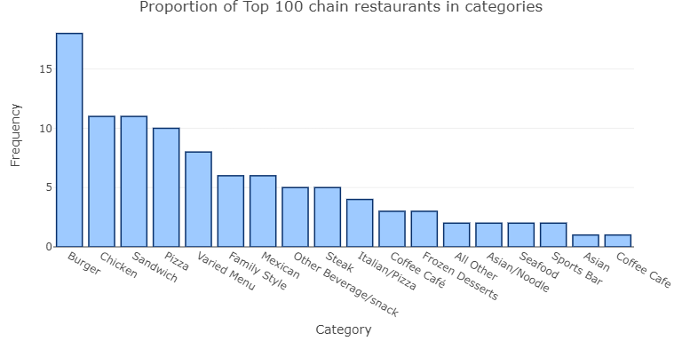
General Analysis-Proportion of Top 100 in categories
By calculating the proportion in segments, the histogram is shown above.
Findings
1.The top 5 categories are Burger,Chicken, Sandwich ,Pizza and Varied Menu. All of them are related to fast food
2.The bottom 5 categories are Cafe, Asian, Sports Bar, Seafood and Noodles All of them are related to specific location,race or ingredient.
3.There are altogether 18 categories in Top 100 chain restaurants, which showed a good level of variation.
4.The Chicken restaurants are four times bigger in number than seafood restaurants in the Top 100 chain.
5.Burger takes up over 15% in number in the Top 100 chain restaurants

Slide 13
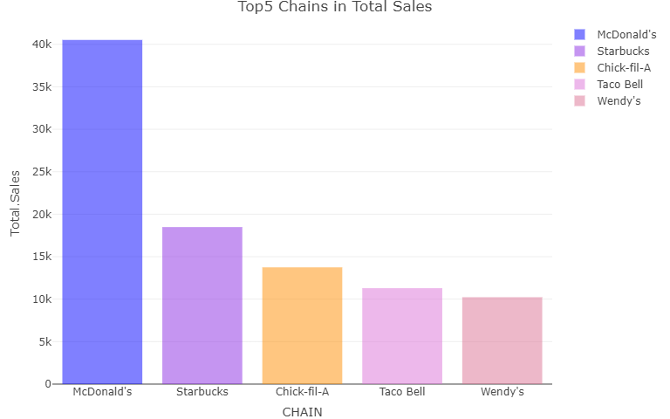
Top Rank Analysis-Top 5 chain in total sales
By calculating top 5 chain restaurants in total sales, the barplot is shown above.
Findings
1.The top 5 restaurants in total sales is McDonald's, Starbucks, Chick-fil-A,Taco Bell and Wendy’s.
2.McDonald’s as the biggest in total sales is twice bigger than Starbucks,the second biggest in total sales.
3.Wendy’s as the fifth biggest restaurants in total sales is slightly over 10000 million dollars.

Slide 14
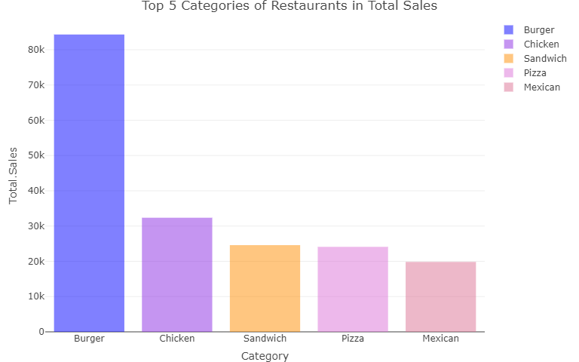
Top rank Analysis-Top 5 categories in total sales.
By calculating top 5 categories of restaurants in total sales. the barplot is shown above.
Findings
1.The top 5 categories of restaurants in total sales are burger, chicken, sandwich ,pizza and Mexican.
2.Burger as the biggest category in total sales is over 80000, more than twice bigger than sandwich,the second biggest category in total sales.
3.Mexican as the fifth biggest category in total sales is just around 20000 million dollars.

Slide 15
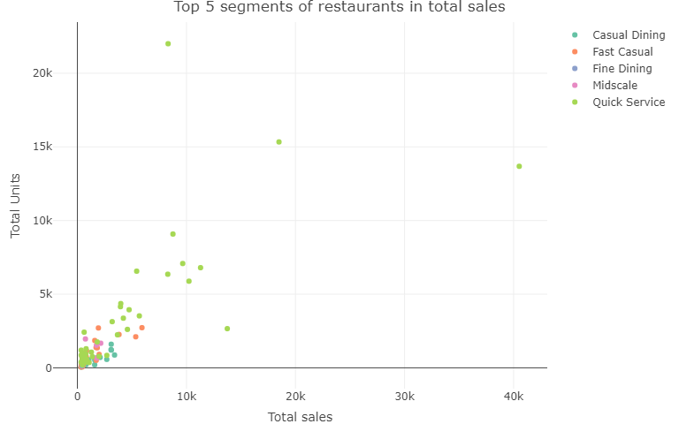
Top rank Analysis-Top 5 segments in total sales.
By calculating top 5 segments of restaurants in total sales. the scatterplot is shown above.
Findings
1.The top 5 segments of restaurants in total sales are quick service, fast casual, casual dining, midscale and fine dining.
2.Quick service as the biggest segments in total sales can be above 20,000, more than four times bigger than fast casual,the second biggest segment in total sales.
3.Most of top segments restaurants are concentrate in 0-10,000

Slide 16
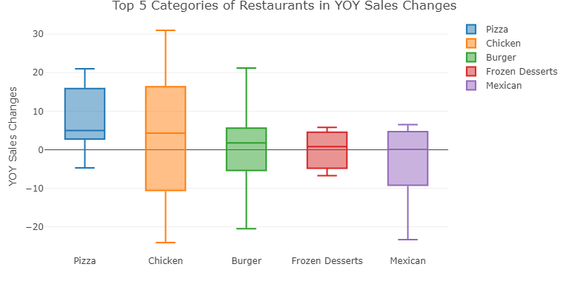
Top5 Analysis-Top 5 categories in YOY sales changes
By calculating top 5 categories of restaurants in YOY sales changes, the boxplot is shown above.
Findings
1.The top 5 chain restaurants in YOY sales changes are Pizza, Chicken, Burger, Frozen Desserts and Mexican
2.Pizza as the biggest category of restaurants in YOY sales changes has an average YOY sales increase slightly above 0 percent, but most increases are concentrated between -5% to 20%
3.Mexican as the fifth biggest category of restaurants in YOY sales changes has an average YOY sales increase around 0 percent, but increases inside this category varied hugely among each other.

Slide 17
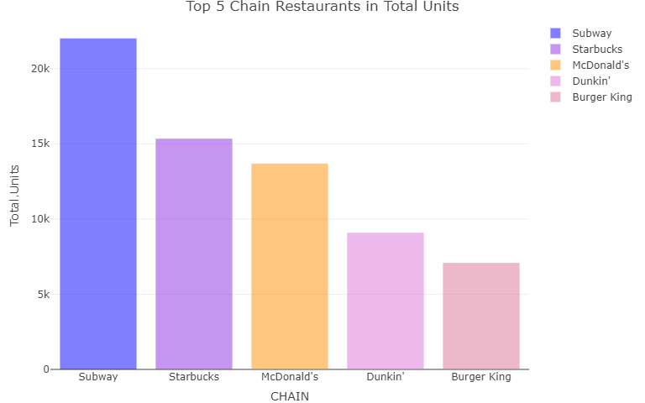
Top5 Analysis-Top 5 chain restaurants in units
By calculating the top 5 chain restaurants in units. the barplot is shown above.
Findings
1.The top 5 chain restaurants in units are Subway, Starbucks,McDonald’s,Duckin and Burger King
2.Subway, as the biggest chain restaurant in units has over 20000 chains, 5000 more than Starbucks, the second biggest chain restaurant in units .
3.Burger King as the fifth chain restaurant in units is around 5000 units, 4 times smaller than the biggest

Slide 18
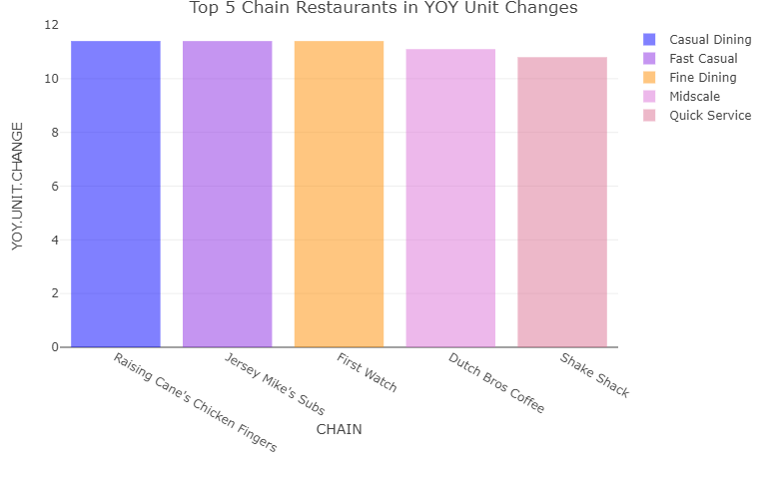
Data Analysis-Top 5 chain in YOY unit changes
By calculating the top 5 chain restaurants in YOY unit changes. the barplot is shown above.
Findings
1.The top 5 chain restaurants in YOY unit changes are Raising Cane,Jersey Mike’s,First Watch,Ducth Bros and Shake Shack.
2.Raising Cane, as the biggest chain restaurant in YOY unit changes has over 10% chains increase,nearly the same with Jersey Mike’s and First Watch.
3.Shake Shack as the fifth chain restaurant in YOY unit changes is just a little bit lower than the biggest, in other words, the top 5 chain restaurant in YOY unit changes is very average.

Slide 19
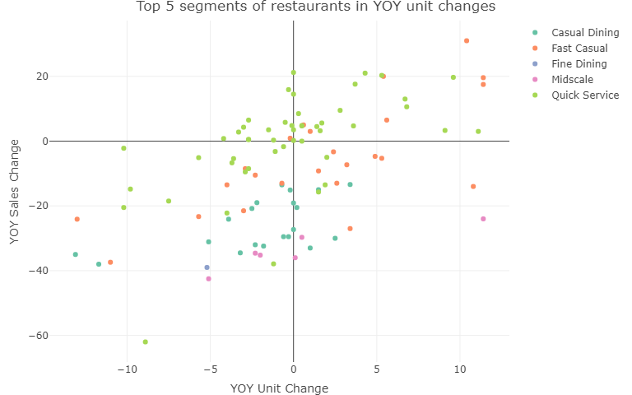
Data Analysis-Top 5 segments in YOY unit changes
By calculating top 5 segments of restaurants in YOY unit changes, the scatterplot is shown above.
Findings
1.The top 5 segments of restaurants in YOY unit changes are Fast Casual, Midscale, Quick Service,Casual Dining and Fine Dining.
2.Elements are scattered in the plot so the even in the same segments, different restaurants witnessed a significantly different in growth rate, which means catering is more based on indivual business.

Slide 20
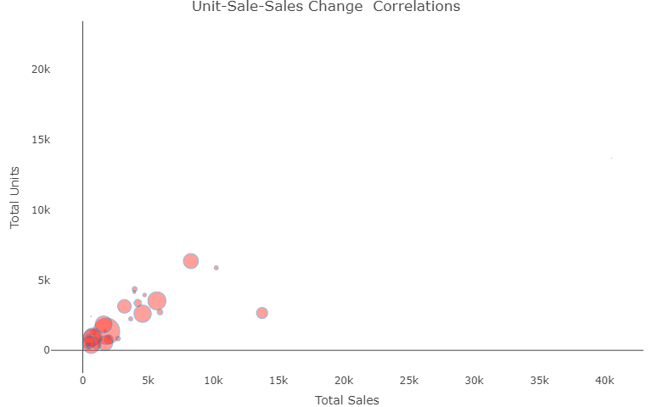
Cross-Elements Analysis-Unit-Sale-Sales Change Correlations
By analyzing the differences between unit, sales and YOY sales changes.
Findings
1.There are no postive or negative, strong or small correlation between these three elements
2.Bigger sales isn’t based on the unit scale,so does YOY Sales change.
3.Small unit restaurants still can have a great sales a significant increase in sales.

Slide 21
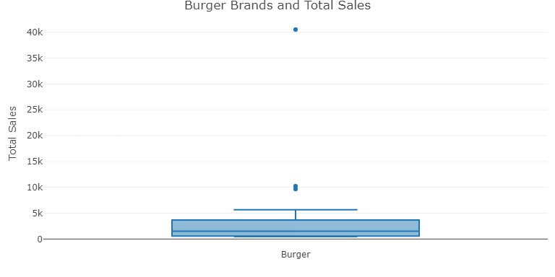
Data Zoom In-Burger brands and total sales
By zoom in to the biggest category and calculating burger brands and total sales, the boxplot is shown above.
Findings
1.Most burger restaurants have total sales range from 377 to 2890.
2.The biggest burger restaurant has over 40000 in sales,much bigger than any other burger restaurants
3.The average burger restaurants sales among the Top 100 is around 1000.
4.There are 3 outliers in the sales, not concentrated with each other.

Slide 22
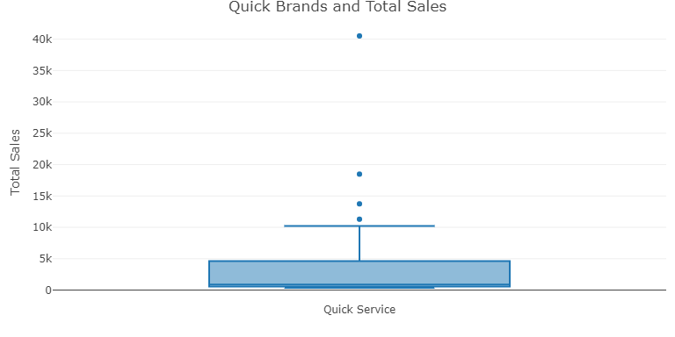
Data Zoom In-Quick brands and total sales
By zoom in to the biggest segment and calculating quick brands and total sales, the boxplot is shown above.
Findings
1.Most quick brands restaurants have total sales range from 377 to 2980.
2.The biggest quick brands burger restaurant has over 40000 in sales,much bigger than any other quick brands restaurants
3.The average quick brands restaurants sales among the Top 100 is around 500.
4.There are 4 outliers in the sales, not concentrated with each other.

Slide 23
Investment Suggestions
If you want to have the best grow in units burger retaurants are the best choices.
If you want to have the best grow in sales quick brands are the best choices.
Most of the Top 100 restaurants witnessed an increase in sales but a decrease in units.
If you want to invest in a brand with a balance of not fierce competition, high increase rate and well known to others, you should choose Shake Shack

Slide 24
Thank You

